Slide 2
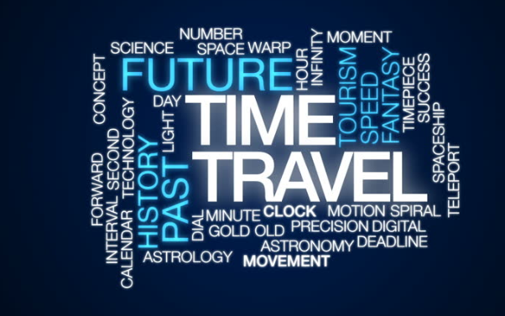

Slide 3
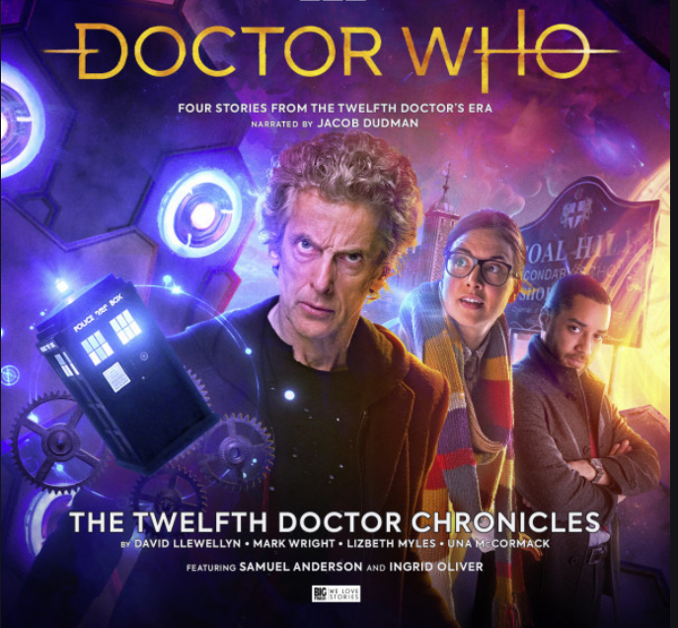
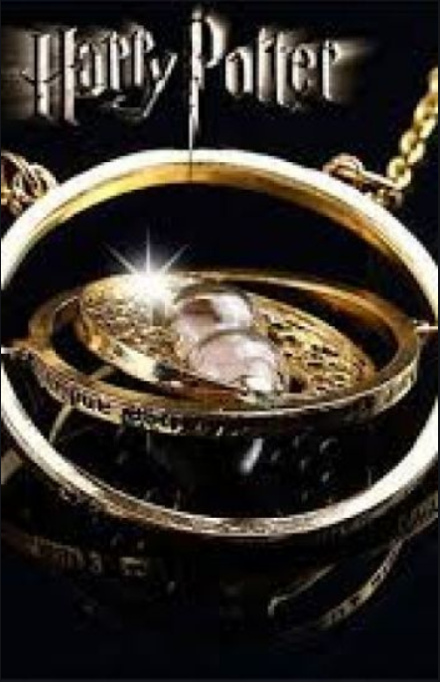
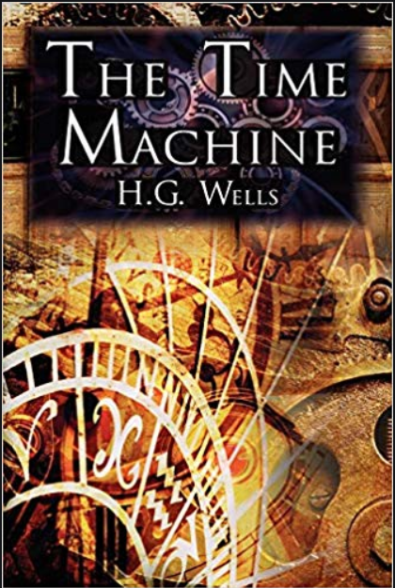
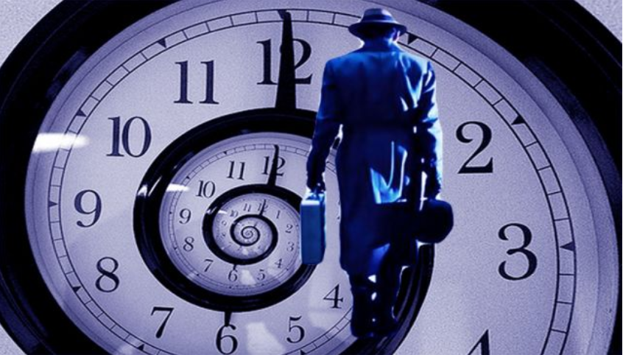

Slide 4
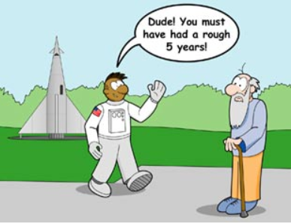
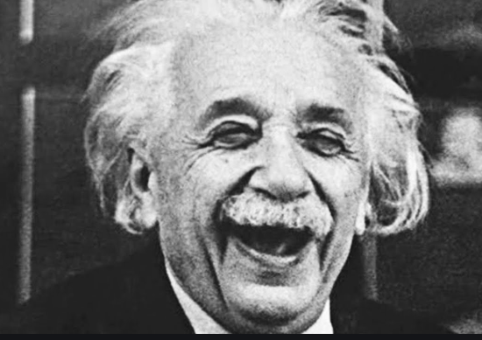
What is time?

Slide 5
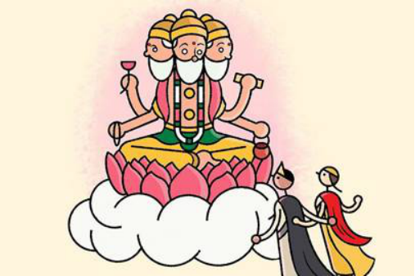
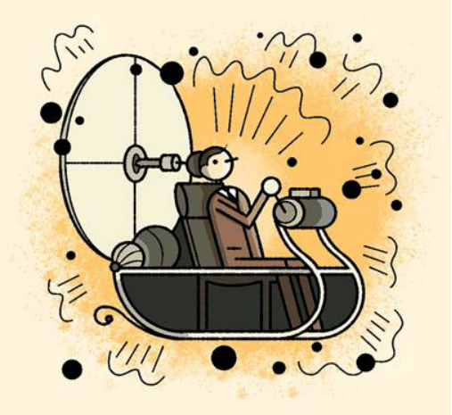
Where did the concept start?
King Kakudmi & Revathi 1895- The Time Machine by H G Wells

Slide 6
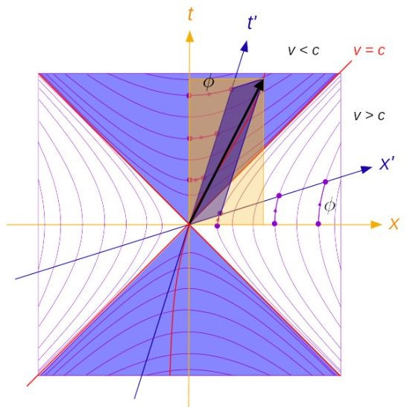
Theoretical proof of the idea
1907- Physicist Hermann Minkowski argued that Einstein’s Special Relativity could be expressed in geometric terms as a fourth dimension.
1949- Kurt Gödel found a solution to Einstein’s work by including “ closed timelike curves” -if you travel far enough, time will loop back around.
Drawback- The universe would have to be spinning - and scientists don’t believe that it is.

Slide 7
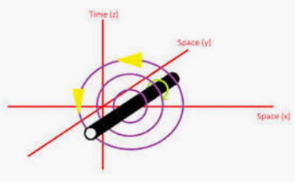
Any theories so far ...
Tipler /infinite cylinder
William jacob ,kornel.
Frank tipler(1974)
10 times sun’s mass
Infinitely long
Frame dragging effect
Light cones tilted
Closed timelike curve
Space -time diagram

Slide 8
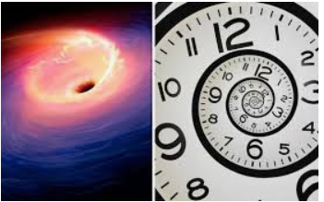
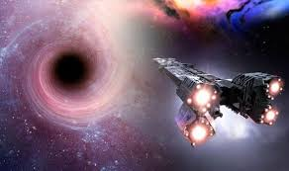
Black hole

Slide 9
Evidences of time travel

Slide 10
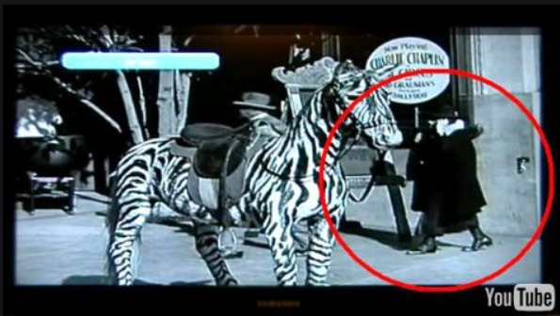
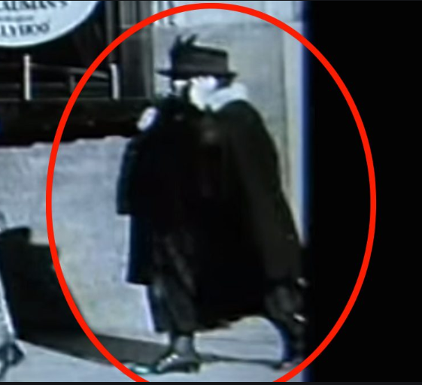
Charlie chaplin time travel..

Slide 11
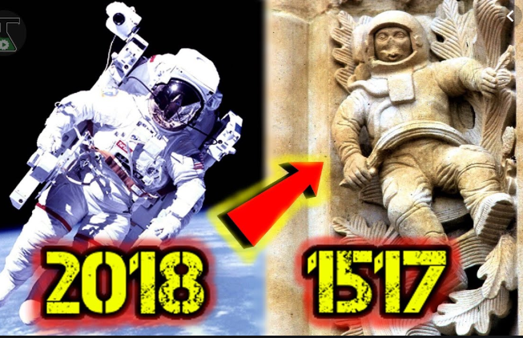
Modern astronaut vs sculpture in 15th century (cathedral-spain)

Slide 12
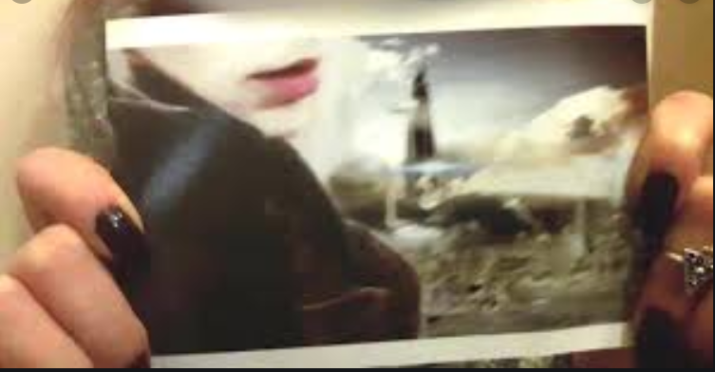
Time traveller from the year 3800(ROBOTIC WORLD)

Slide 13
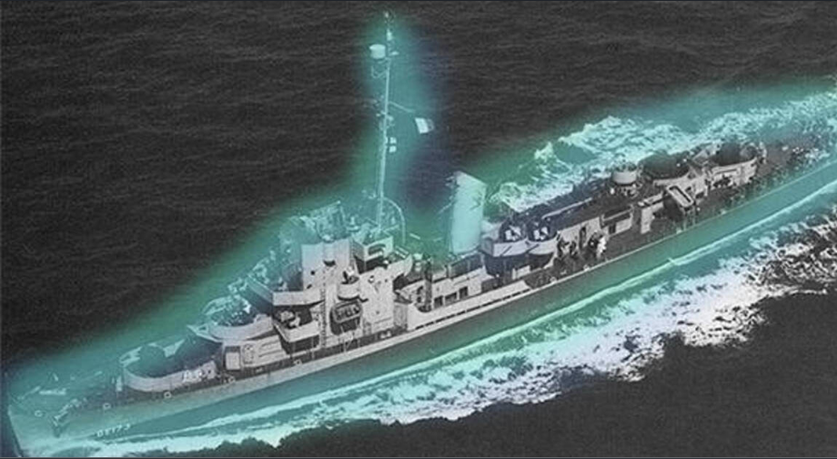
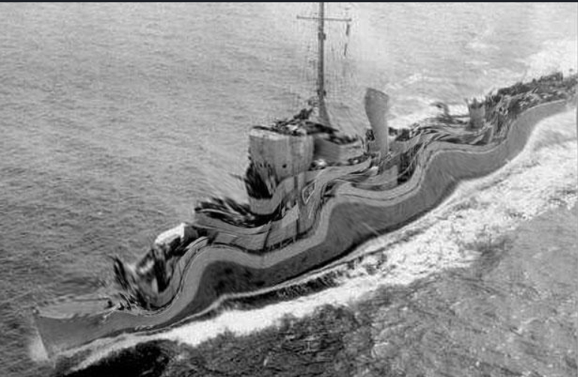
Philadelphia experiment

Slide 14
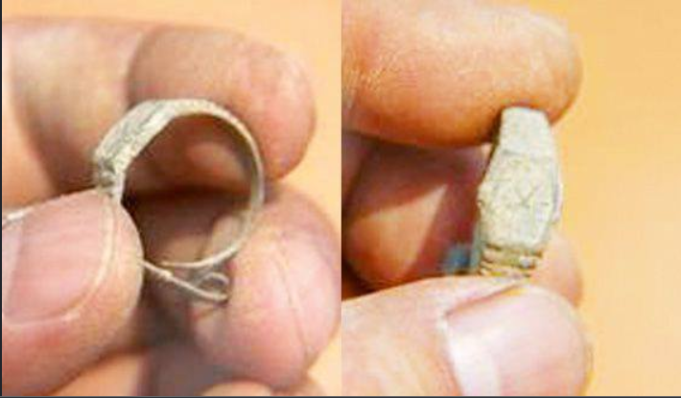
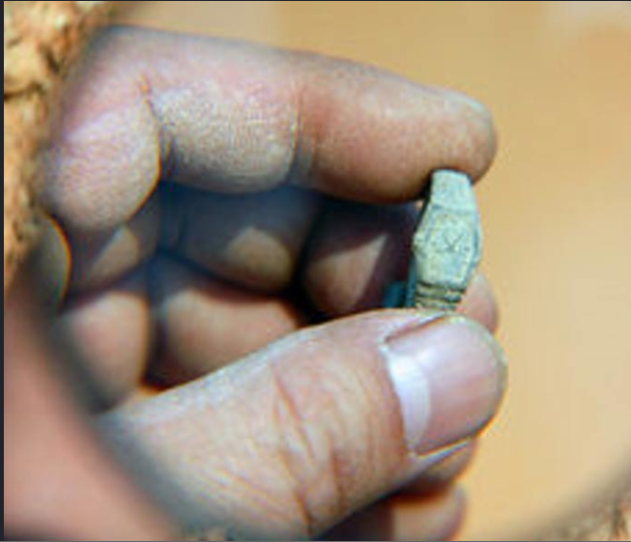
Timeless mystery

Slide 15
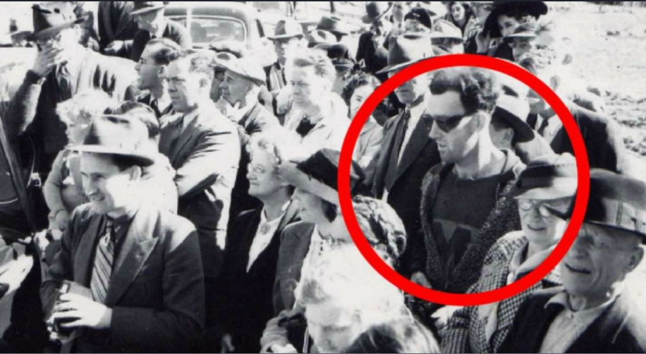

Slide 16
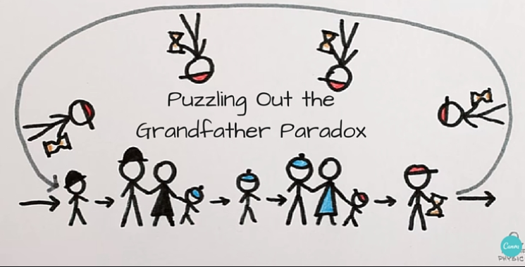
Grandfather paradox

Slide 17
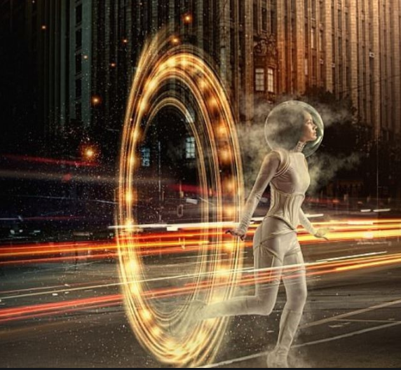
What is mental time travel?

Slide 18


Slide 19


Slide 20


Slide 21
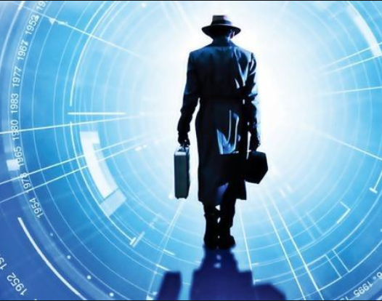
SAFE TRAVELS

